Slide 1

OBJECT DETECTION
Sabbiu Shah
Sagar Adhikari
Samip Subedi

Slide 2
Vision
Acquiring
Processing
Understanding

Slide 3

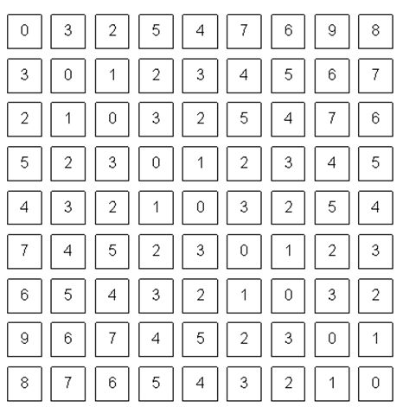
Vision
What we see
What Computer sees

Slide 4
Computer Vision
Task that include methods for
Acquiring, processing and understanding
digital images.
Produce numerical or symbolic information.

Slide 5
Object Detection
Field of Computer Vision
Focuses on “Where” rather than “What”

